Slide 1
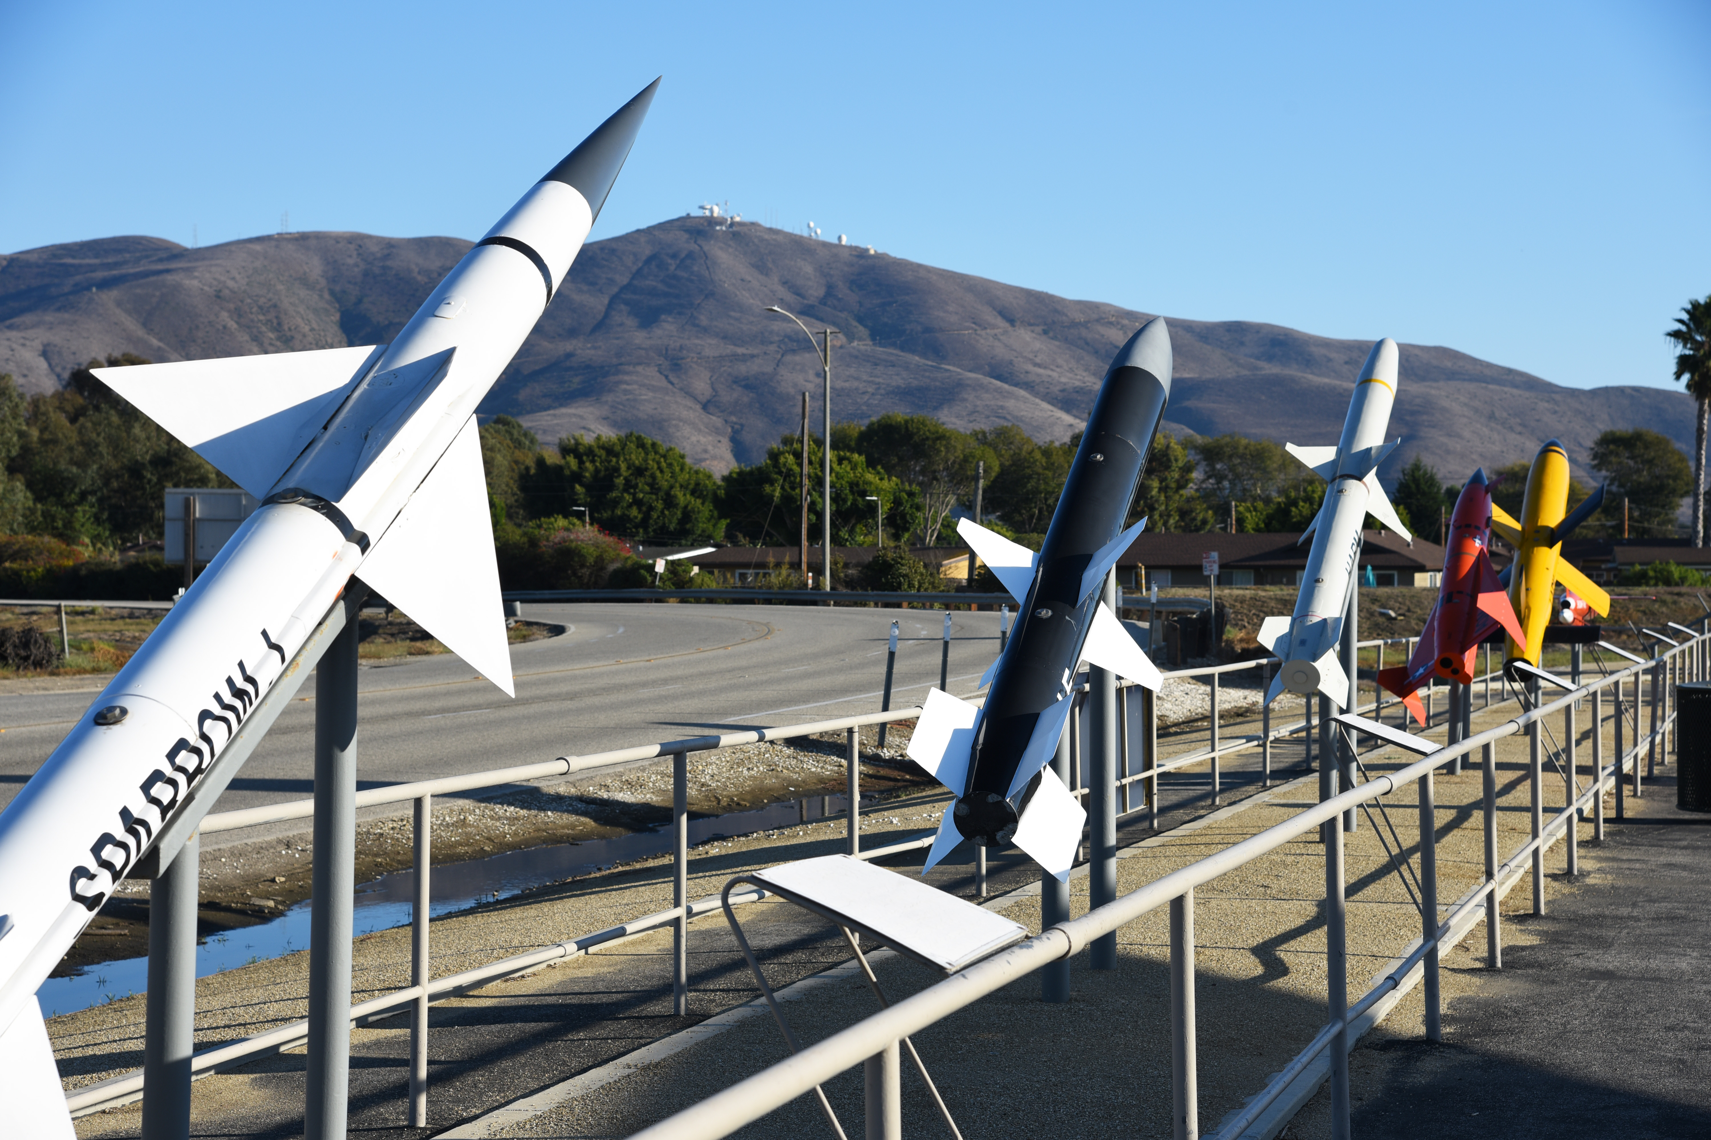
Smart Projectile
Jed Fazler | Noah Moffeit | Nicholas Samuda | Robert Smith
Notes:
https://visualhunt.com/f7/photo/32891036558/2ed24545c0/

Slide 2


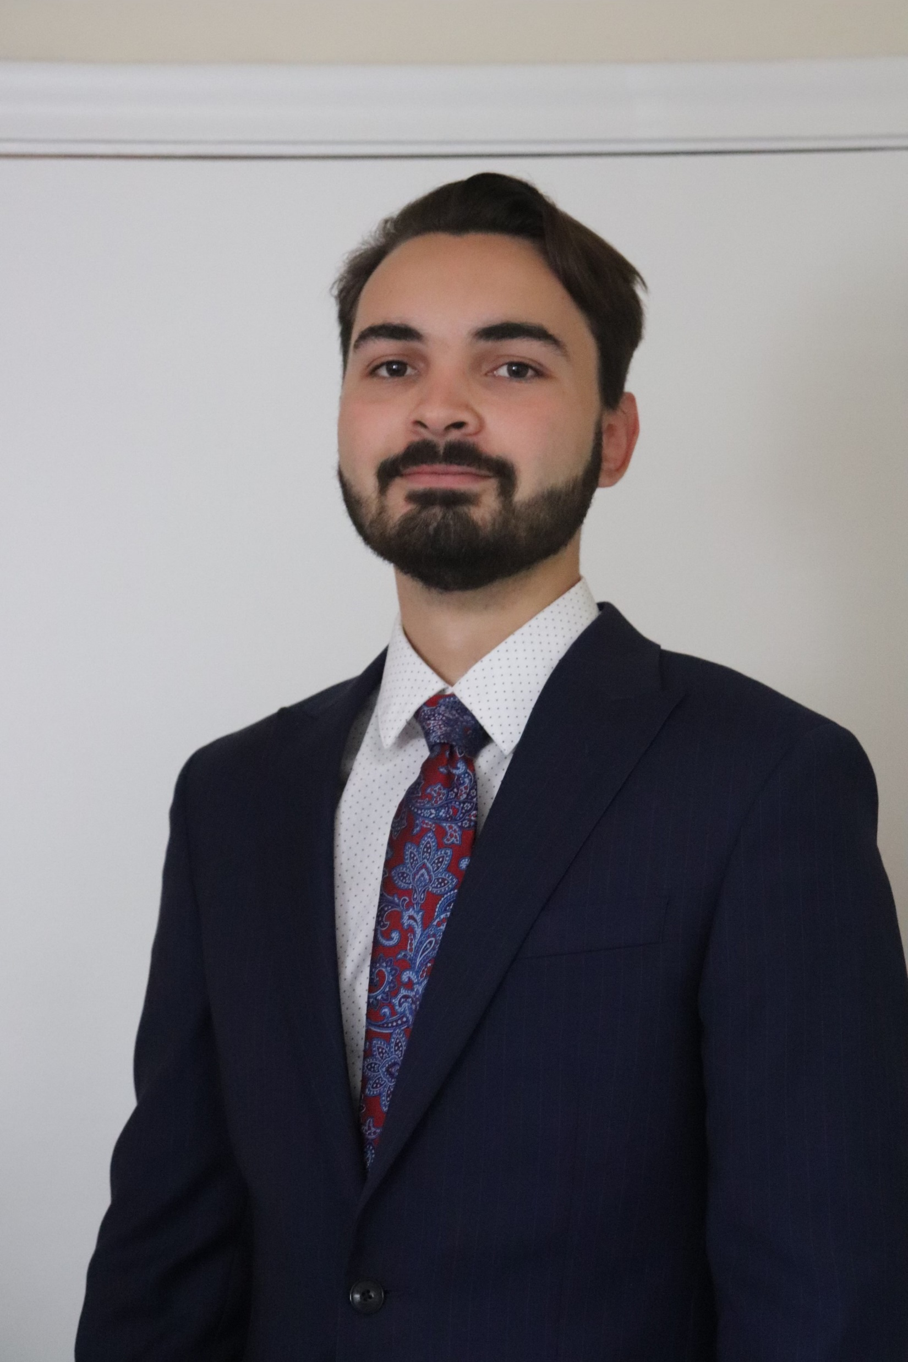
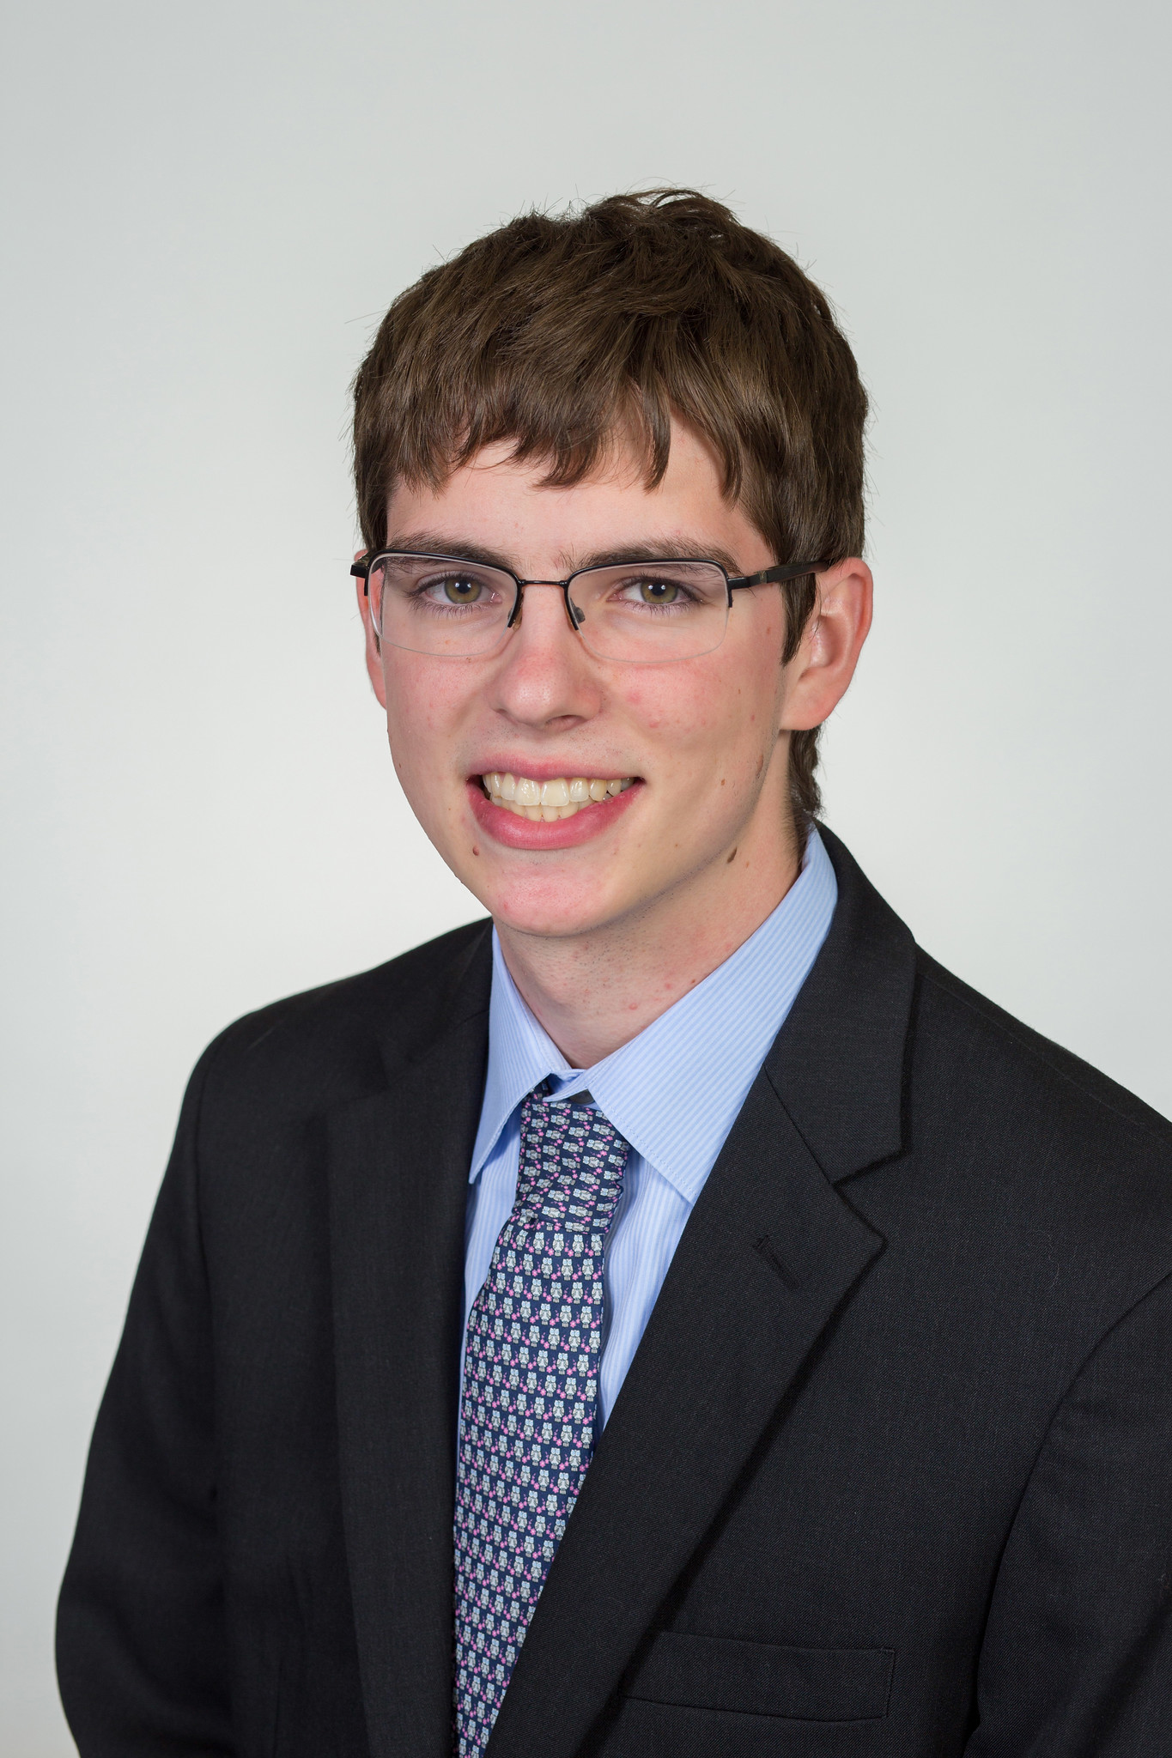
Team 504 Introductions
Jed Fazler
Field Engineer
Noah Moffeit
Test Engineer
Nicholas Samuda
Systems Engineer
Robert Smith
Research Engineer
Noah Moffeit

Slide 3
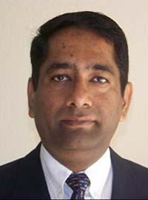
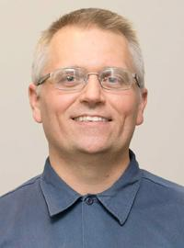

Sponsor and Advisor
Dr. Rajan Kumar
Dr. Jonas Gustavsson
Noah Moffeit
Notes:
Our project sponsor is Dr. Rajan Kumar, he is an Associate Professor at the FAMU-FSU college of engineering and the Director of the Florida Center for Advanced Aero-Propulsion. Our project advisor is Dr. Jonas Gustavsson who works as an Associate Scientist at FCAAP.

Slide 4
Project Objective
Design and develop a smart projectile technologies that can sense and adapt to harsh conditions.
Noah Moffeit
Notes:
The objective of the Smart Projectile project is to create a technology that will allow for a missile to detect and adapt to harsh conditions.

Slide 5

Background
High angles of attack induce flow separation reducing fin effectiveness
Noah Moffeit
Notes:
The current underling issue encountered by an air-to-air missile, falls on their inability to rapidly maneuver through high angles of attack. The projectile will begin its flight by cruising through the air, searching for its intended target. Upon detection of the target, the projectile will use its control surface, which are typically canards or fins, to change its trajectory allowing it to chase down its target. The problem arises when the projectile must

Slide 6
Key Goals
Design an application of projectile maneuverability technology
Analysis inside the Polysonic Wind Tunnel
Prototype for proof of actuation
Automatic stability and trajectory control
Noah Moffeit

Slide 7

Customer Needs
Withstand loads from Mach 4 windspeeds
Adapts without user input
Utilizes a control surface other than fin deflection
Can track and follow a single target
Detect conditions in which flow detachment will occur
Noah Moffeit

Slide 8



Assumptions
Design of propulsion system is optional
Projectile can be stored in preexisting containers
Deployment will not be projectile’s responsibility
Jed Fazler
Notes:
We made multiple assumptions to help limit the scope of this project. The first of those assumptions was that the design of a propulsion system is optional. As we are focusing on the sensing and controls parts of this project, we felt that development of a propulsion system would

Slide 9
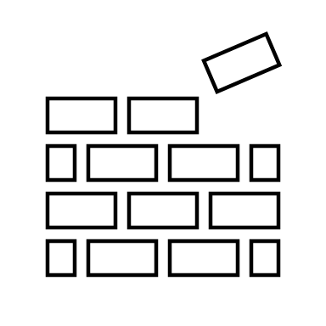

Functional Decomposition
POWER
SENSING
ACTUATION
STRUCTURE
Jed Fazler
Notes:
We’ve identified 4 main systems that we will be dealing with in this project, those being the power, sensing, actuation, and structure systems. Each system is broken down into a series of subsystems, with each subsystem serving a specific role in the projectiles operation. We developed these systems and subsystems from our customer needs, where we identified the basic functions of the projectile as interpreted from the responses our customer gave.

Slide 10

Functional Decomposition
Storage
Provides power for components
POWER
Transmission
Transfers power to components
Jed Fazler
Notes:
The power system is split into the storage and transmission subsystems. The power storage subsystem's function is to act as the battery for the rest of the projectile. This subsystem is important because this is where all the projectiles' components will draw energy from. The power transmission subsystem deals with transferring the power from the storage subsystem to the rest of the systems. The power system has close connections to the actuation and sensing systems, since without the power storage and power transmission subsystems they would not be able to operate.

Slide 11

Functional Decomposition
Sensors
Monitors sensor data
SENSING
Interprets sensor data
Signaling
Transmits response signal
Jed Fazler
Notes:
The sensing system is broken down into the sensors and signaling subsystems. The sensors subsystem deals with monitoring data from various instruments that provide readouts for important conditions such as velocity, altitude, and flow attachment. The signaling subsystem has two functions, it uses the sensor data for calculations to possible adjustments to the control systems and then transmits the signal to move to the controls system. This system is intertwined with both the power, due to the need for powered instruments and a computer, and the controls system, due to the fact that the controls system relies on signals from this system for adjustments.

Slide 12
Functional Decomposition
Flow
Maintains flow attachment
Controls pitch
ACTUATION
Mechanical
Controls roll
Controls yaw
Jed Fazler

Slide 13

Functional Decomposition
Maintains integrity
STRUCTURE
Protects components
Jed Fazler

Slide 14






Future Work
Concept Generation
Modeling
Targets and Metrics
Concept Selection
Jed Fazler

Slide 15
Project Description and Key Goals
This project aims to create a technology that can be applied to many projectile configurations, allowing the projectile to maneuver adaptively through unforeseen, hazardous environments. The technology developed will detect said obstacles or conditions and actuate the projectile autonomously.
The key goals were selected to itemize the main objectives that must be accomplished over the duration of the project based on the project’s description and advice from the project’s sponsor. The following are the goals or milestones we have derived to ensure the project’s completion:
  Conceptualize and research 5 different innovative ways to maneuver a projectile.
  Choose one of these designs to expand upon and develop into a working design.
  Develop innovative technologies that can be implemented into the projectile allowing for smart capabilities.
  Develop a way for the projectile to adapt to its environment or obstacles through autonomous actions.
  Construct a scaled down model of the projectile for use in wind tunnel testing to verify desired aerodynamic characteristics of design.
  Construct a prototype projectile to test actuation of the smart functionality within the projectile.

Slide 16
Market
The primary market for this project was seen as the company or organization that the product would be directly constructed for and would use the product.
Primary Markets:
  Florida Center for Advanced Aero Propulsion (FCAAP)
The secondary markets are a makeup of other companies or organizations who may benefit from or would be interested in purchasing the results of this project.
Secondary Markets:
  Air Force Office of Scientific Research (AFOSR)
  Lockheed Martin
  Raytheon Technologies
  Northrop Grumman

Slide 17




Assumptions
Propulsion
It is assumed that:
Projectile deployment
Entailing storage
Transportation
Initial launch
will be facilitated by technologies already implemented in the projectile. It is also assumed that the projectile will remain within earth’s atmospheric conditions for its use.
Deployment
Storage

Slide 18
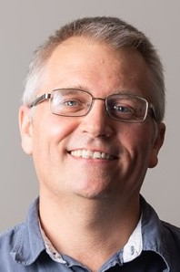
Stakeholders
The stakeholders for this project include all parties who will have influenced the design of the technologies produced by the project as well as those who have invested time and other resources into the project.
Dr. Shayne McConomy
Dr. Rajan Kumar
Dr. Jonas Gustavsson
FCAAP
FAMU-FSU College of Engineering

Slide 19
Customer Needs
How do you think current control surfaces and their actuation can be improved? | Current control surfaces require clean flow, which is not realistic at high angles of attack, so that’s something. | Projectile accommodates for attached flow over control surfaces.
What draw backs come with standard fin deflections as a control surface? | Must have clean flow to actuate properly. Size and weight that come with actuation mechanism | Projectile control surfaces will be suitable effective even in detached flow.
What Mach numbers would be expected for this projectile? | FCAAP polysonic wind tunnel can’t go faster than Mach 5. We’ll probably test Mach 4. | The projectile can withstand Mach 4.
What slenderness ratio of the projectile would be appropriate? | Would be nice if it could be tied into what we have done already. Matching a baseline design here at FCAAP. 8-10 | The projectile uses a basic axisymmetric body configuration based on previously tested models.

Slide 20
Customer Needs
Do we need to worry about designing the method of propulsion? | Don’t worry about designing the propulsion as we cannot have it modeled in the wind tunnel. | Propulsion is beyond the scope of this project.
By the end of this project, what level of manufacturing should be accomplished to demonstrate our results? | Small model for testing control surfaces in wind tunnel, larger model for demonstration purposes and sensing capabilities. Radar sensors possible option. | The projectile is modelled for aerodynamic testing and then prototyped for proof of actuation.
What conditions do you expect the projectile to operate in? | Projectile should go where the target goes. High angles of attack. Initial deployment shockwaves and vortices. Vibrations in supersonic can affect and disrupt the electronics. | The projectile has a way to rapidly adapt to the conditions that exist during deployment.
Should the projectile be able to actuate without user input? | Yes | The projectile is automatically operated.

Slide 21
Customer Needs
Should favorable aerodynamic characteristics be prioritized over functionality? | No, it should accomplish the task while minimizing negative effects. Compare to previous results. | Maintaining aerodynamic characteristics is secondary to maintaining control surface effectiveness.
What is considered a “harsh” or “hazardous” | Vortices, and shockwaves off the parent aircraft. High angles of attack | The missile adapts to high pitch angles.
What will be the preferred method of flow visualization? | It looks good. Better for showing actuation effects. Could be done with shadow graph in the wind tunnel. Not necessary but helpful. | Flow visualization will be done through other tests such as shadowgraph or oil flow.
Will the projectile also have to accommodate targeting? | Does not necessarily need to sense targets, could also sense high angles of attack. | The missile can sense its angle of attack in various scenarios.

Slide 22
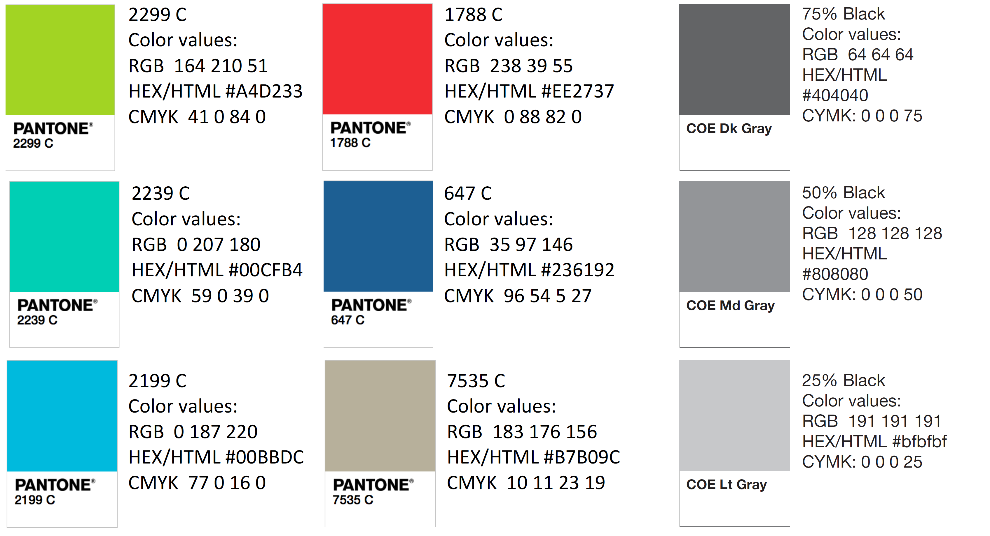
Color Palette
How do you think current control surfaces and their actuation can be improved? | Current control surfaces require clean flow, which is not realistic at high angles of attack, so that’s something. | Projectile accommodates for attached flow over control surfaces.
What draw backs come with standard fin deflections as a control surface? | Must have clean flow to actuate properly. Size and weight that come with actuation mechanism | Projectile control surfaces will be suitable effective even in detached flow.
What Mach numbers would be expected for this projectile? | FCAAP polysonic wind tunnel can’t go faster than Mach 5. We’ll probably test Mach 4. | The projectile can withstand Mach 4.
What slenderness ratio of the projectile would be appropriate? | Would be nice if it could be tied into what we have done already. Matching a baseline design here at FCAAP. 8-10 | The projectile uses a basic axisymmetric body configuration based on previously tested models.

Slide 24


Slide 25

